Slide 1


Government Engineering College – Bhuj A Final semester internship Presentation at Indian Oil Corporation Limited
Present by :- Kareliya Isha
Enrollment no :- 210150105033
Academic Guide :- Dr. Williams J. Koshy
Industrial Guide :- Mr.Ashutosh Sharma

Slide 2

COMPANY PROFILE
Name: Indian Oil Corporation Limited Founded 1964
Headquarters: New Delhi,
Ownership: Public Sector Undertaking (PSU) under the Ministry of Petroleum and Natural Gas
Government of IndiaKey Business Areas Operates 11 of India's 23 refineries, with a refining capacity of ~80.6 MMTPA (Million Metric Tonnes Per Annum)
Pipelines: Manages a vast network of over 15,000 km of crude oil, product, and gas pipelines.Marketing: Largest network of fuel stations in India, with over 36,000 retail outlets.

Slide 3
Produces key products like polypropylene, PTA, and various polymers.
Natural Gas: Growing presence in the LNG and city gas distribution sectors.
R&D & Innovation: Has a world-class R&D center focused on sustainable energy solutions and advanced technology development.
Key Products : Petrol, Diesel, LPG, Kerosene, Aviation Turbine Fuel (ATF)Lubricants(Servo)Petrochemicals & Polymers Natural Gas (including CNG and PNG)Global Presence : Operates in over 30 countries, with major projects in Sri Lanka, Mauritius, UAE, and more. Achievements & Impact Ranked as one of the Fortune Global 500 companies. Contributes to ~40% of India’s petroleum products market share.
Vision: The Energy of India and a globally admired company.
Mission: To provide energy access to millions with sustainable and innovative solutions.

Slide 4
FIRE SAFETY EQUIPMENTS AND DEVICES
Smoke & heat detectors (usually in the ceiling)
Fire and emergency alarms (switched on by emergency buttons or handles)
Fire and emergency lights (red)
Water sprinklers (usually in the ceiling)
Fire extinguishers (various types according to a class of fire)
Fire blanket (to wrap around the burned person or to cover devices on fire)
Fire and emergency exits
Fire break area (for assembly of people)

Slide 5
Personal Protective Equipment
Safety Shoes
Safety Helmet
Goggles
Hand Gloves
Safety Mask
IFR suit
Safety Belt etc...

Slide 6
Various products of IOCL
Fuel gas and fuel oil
LPG
Naphtha
Motor spirit
Aviation Turbine Fuel
Kerosene
High speed diesel
Light diesel oil
Bitumen
Benzene & Toluene
Linear alkyl benzene
Butene
Sulphur

Slide 7
PLANT PROCESS DESCRIPTION
First crude goes to desalter where remove contamination, water from crude oil
Before it enters the distillation column. That prevent corrosion, fouling and catalyst poisoning in downstream process.
After that Pre-heated crude temp between 280-350 ºC enter into distillation column operates at atmospheric pressure with heat supplied by furnace.
Lighter Fractions like naphtha condense at top , while heavier fraction production
LPG, naphtha side draws kerosene, diesel which known as Atmospheric Gas oil
( AGO ).
Bottom residue sent to the vaccume distillation unit ( VDU )

Slide 8
some heavy hydrocarbons in crude oil decompose (thermal cracking) if heated too much under normal pressure. By lowering the pressure, the boiling points of these heavy fractions decrease, allowing separation at lower temperatures.
Separation: The column separates the feed into various fractions based on boiling points
Light vacuum gas oil (LVGO) — used for diesel or further cracking
Heavy vacuum gas oil (HVGO) — used for catalytic cracking or lube oil production.
Vacuum Residue (VR) — the heaviest fraction, often used for asphalt, coking, or further process.

Slide 9
Fluidized Catalytic Cracking Unit ( FCCU ) :
( Gujarat Refinery Secondary Process Functioning )
Fluidized : The catalyst is a fine powder (like sand) that, when mixed with the hydrocarbon vapor, behaves like a fluid. High-speed vapor flow lifts and suspends the particles, creating a fluidized bed.
Catalytic: The process uses a zeolite-based catalyst to speed up cracking reactions without being consumed itself
Cracking: The process breaks large, heavy hydrocarbon molecules into smaller, lighter, and more valuable ones.

Slide 10
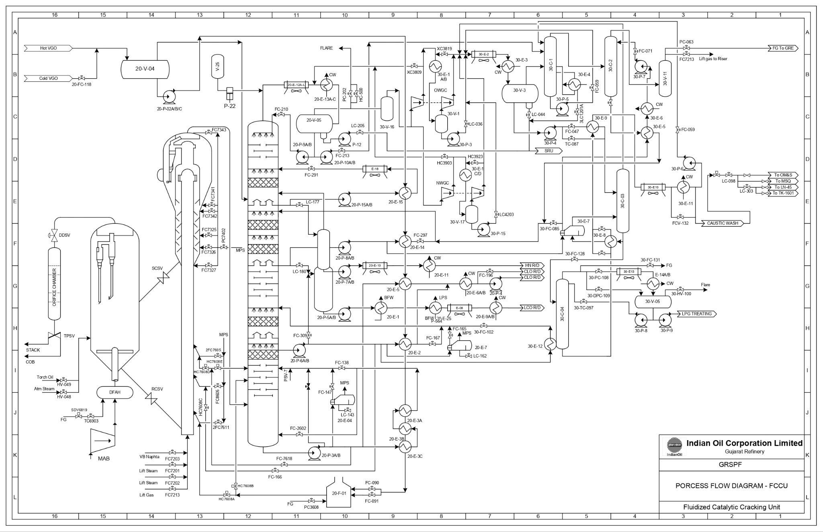

Slide 11
The FCC unit cracks heavy hydrocarbons into lighter molecules using a catalyst in a fluidized state. The process boosts the production of high-value products like gasoline and propylene.
Main Reactions : Cracking: Large hydrocarbons → Smaller hydrocarbons (gasoline, LPG, etc.)Side Reactions: Isomerization, hydrogen transfer, dehydrogenation
Working Principles:
1. Feed Preheater:
Preheats the feedstock (vacuum gas oil) before entering the reactor.
Temp: ~260–370°C
Pressure: 3–5 bar
Riser Reactor: Main cracking zone where hot catalyst contacts the feed, causing thermal and catalytic cracking.
Catalyst: Zeolite-based
Temp: ~500–550°C
Pressure: 1.7–3.5 bar

Slide 12
Cracking happens in seconds, and the mixture moves to the reactor vessel.
Reactor Vessel:
Separates cracked vapors from the catalyst. The hydrocarbons rise to the fractionator, while the catalyst (now deactivated) goes to regeneration.
Temp: ~520°C
Pressure: ~2–3 bar
Cyclones (in Reactor & Regenerator): Separate catalyst particles from hydrocarbon vapors or flue gases
Regenerator: Burns off coke deposits from spent catalyst with air, restoring catalyst activity.
Temp: ~650–730°C
Pressure: ~3–4 bar
Reaction: C + O₂ → CO₂ (+ he)
Catalyst Stripper: Removes trapped hydrocarbons from the catalyst using steam before regeneration.
Temp: ~500°C

Slide 13
Cyclones (in Reactor & Regenerator):
Separate catalyst particles from hydrocarbon vapors or flue gases
Regenerator:
Burns off coke deposits from spent catalyst with air, restoring catalyst activity.
Temp: ~650–730°C
Pressure: ~3–4 bar
Reaction: C + O₂ → CO₂ (+ he).
Catalyst Stripper :Remove trapped hydrocarbons from the catalyst using steam before regeneration.
Temp: ~500°C
Main Fractionator (Distillation Column): Separates cracked products into different fractions
Overhead: Dry gas, LPG
Top/mid: Naphtha (for gasoline)
Bottom: Light cycle oil, slurry oil
Temp ~120°C

Slide 14
MASS BALANCE OF FRACTIONATOR :
Feed (vaccume gas oil) :
Volumetric Flow Rate (240m³/hr )* Density( 890kg/m³)
(From Panel Data)
= 213840kg/hr
Products:
2.LPG : 40m³/hr *550
= 22000kg/hr
3.Gasoline : 117*720
= 84240kg/hr
4. LCO : 46*910
=41860 kg/hr

Slide 15
5.CLO : 15*930 =13950 kg/hr
6.Lean Gas : 4000kg/hr
7. Coke : 6894.24 kg/hr
Total Product mass flow rate= 2,11,124 kg/hr
EFFICENCY( ŋ ) = Total Product Mass Flow Rate \ Feed Mass Flow Rate*100
= 211124\2113840*100
= 98.73%
❖ Where 1.27% loss expected as vapour losses or measurement inaccuracies

Slide 16
ENEGRY BALANCE OF FURNACE
Qfuel = Q absorbed + Q flue gas
Given Data :
Mass flow rate of fuel = 338 kg/h
Density of fuel gas = 0.89 kg/Nm3
Net Calorific Value of fuel = 11,000Kcal/kg
Mass flow rate of VGO feed = 213840 kg/hr
Specific Heat Capacity of VGO feed = 0.47 kcal/kg K
Inlet Temperature of VGO feed = 316 °C
Outlet Temperature of VGO feed = 350 °C
Temapture Rise of VGO feed = 34 °C

Slide 17
Q released = mass flow rate of fuel * Net calorific Value
= (338 kg/hr) * (11,000 Kcal/kg)
= 3720200 Kcal/hr
= 3.7202 Gcal/hr
Q absorbed = m*Cp*ΔT
= (213840kg/hr) * ( 0.47 Kcal/kg 0C ) * ( 340 C)
= 3417163 Kcal/hr
Efficiency of the Furnace = Q absorbed / Q released * 100
= 3417163 / 3720200 * 100
= 91.85 %

Slide 18
Air Fin Heat Exchanger Design :
External Diameter of tube = 0.026m
Internal Diameter of Tube = 0.020m
Length of tube = 10m
density of fluid = 4.112
Thermal conductivity = 0.00282
heat capacity = 1.327
dynamic viscosity = 0.00114
velocity = 7 m/s
Tube side HTC
Re = ⲣVD/𝝁
= 2871
Pr = cp𝝁/K
= 0.1

Slide 19
3. Nu = 0.035 *Re 0.6*Pr 0.36
= 16.36 4.
h = Nu*K/Di
= 21.91 W/m²
Air side HTC
Thermal conductivity (k): 0.026
Specific Heat Capacity (cp): 1005
Dynamic Viscosity (μ): 1.8 × 10⁻⁵
Density (ρ): 1.174 kg/m³
Velocity (V) = 5 m/s

Slide 20
Reynolds Number (Re): 6578
Using the Dittus-Boelter equation: Nu = 0.27 *Re^{0.63} * Pr^{0.36}
Where
Prandtl Number (Pr): 0.696
Re: 6578
Nusselt Number (Nu): 259.1
Convective Heat Transfer Coefficient: h_o = Nu*K/D = 336.7
Applying the fouling factor
Heff = h_o* effective factor
= 336.7*0.99
= 335.4 W/m²K

Slide 21
3. Overall Heat Transfer Coefficient (U):
Using the overall heat transfer coefficient equation: 1\U = 1/ht + Dout/Ktube ln (Dout/Din)+1/heff =
ln (2.5) = 0.916
1/U = 0.049
U = 20.40 W/m² K
Q = U*A*ΔT
= 1780.42 KW

Slide 22
PROBLEM STATEMENT
Statement :-
In a Fluid Catalytic Cracking (FCC) unit, the clarified oil (CLO) rundown product often exits at a high temperature of approximately 250°C, which is not desirable for downstream processes or product handling.
Description:-
To address this, a steam generator is integrated into the system, leveraging the excess heat from the hot CLO stream to produce steam. This approach effectively reduces the cooling requirements for the CLO, minimizing the need for external cooling utilities and improving overall energy efficiency. The generated steam can be distributed across the refinery for various heating applications, such as preheating feedstocks, driving turbines, or supporting distillation processes. By repurposing waste heat, the refinery not only enhances sustainability but also achieves significant cost savings, making the operation more energy-efficient and economically viable.

Slide 23
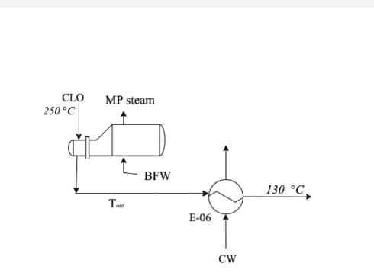

Slide 24
CLO Cooling and Steam Generation Calculations
1. Energy Required to Cool CLO
We use the formula:
Q_cooling = m_CLO × C_p × (T_initial - T_target)
Where:
m_CLO = 13,950 kg/h
C_p ≈ 2.2 kJ/kg°C (for hydrocarbons)
T_initial = 250°C, T_target = 130°C
Q_cooling = 13,950 × 2.2 × (250 - 130) = 3,374,400 kJ/h
2. Chilled Water Required Before Steam Generator
The energy removed must be absorbed by chilled water.
Formula: m_water = Q_cooling / (C_p_water × (T_out - T_in))
With:
C_p_water = 4.18 kJ/kg°C
T_in = 10°C, T_out = 20°C

Slide 25
m_water = 3,374,400 / (4.18 × (20 - 10)) ≈ 88,105 kg/h
3. Steam Production
We generate steam using the energy available in the CLO until it cools to the steam saturation temperature (195°C).
Formula: Q_steam = m_CLO × C_p × (T_initial - T_steam)
Then, we use the latent heat of steam (at 13.4 kg/cm², h_fg ≈ 2013 kJ/kg):
m_steam = Q_steam / h_fg
Calculating:
Q_steam = 13,950 × 2.2 × (250 - 195) = 1,689,900 kJ/h
m_steam = 1,689,900 / 2013 ≈ 1,830 kg/h
4. Chilled Water Requirement After Steam Generator
After generating steam, the CLO is still at 195°C, so we only need to cool it down to 130°C with chilled water.
Formula: Q_remaining = m_CLO × C_p × (T_steam - T_target)
Then, chilled water flow becomes:
m_water_after = Q_remaining / (C_p_water × (T_out - T_in))

Slide 26
Calculating:
Q_remaining = 13,950 × 2.2 × (195 - 130) = 2,197,800 kJ/h
m_water_after = 2,197,800 / (4.18 × (20 - 10)) ≈ 47,724 kg/h
5. Cost and Profit Analysis
Steam revenue:
Revenue = (Steam produced / 1000) × Steam price
Steam price = ₹5,000/ton
Revenue = (1,830 / 1000) × 5,000 ≈ ₹9,148/h
Chilled water cost (assumed ₹0.05/kg):
Cost (before) = 88,105 × 0.05 ≈ ₹4,405/h
Cost (after) = 47,724 × 0.05 ≈ ₹2,386/h
Net profit:
Net profit = Revenue - Chilled water cost (after)
Net profit ≈ ₹9,148 - ₹2,386 ≈ ₹6,761/h
6. Break-even Time
If the installation cost is ₹20 lakh:

Slide 27
Break-even time = Installation cost / Net profit per hour
Break-even time = 20,00,000 / 6,761 ≈ 296 hours
Converting to days:
296 / 24 ≈ 12.3 days
✅ Final Summary
Chilled water before steam generator: 88,105 kg/h
Chilled water after steam generator: 47,724 kg/h
Steam produced: 1,830 kg/h
Steam revenue: ₹9,148/h
Net profit: ₹6,761/h
Break-even time: 12.3 days

